Slide 1

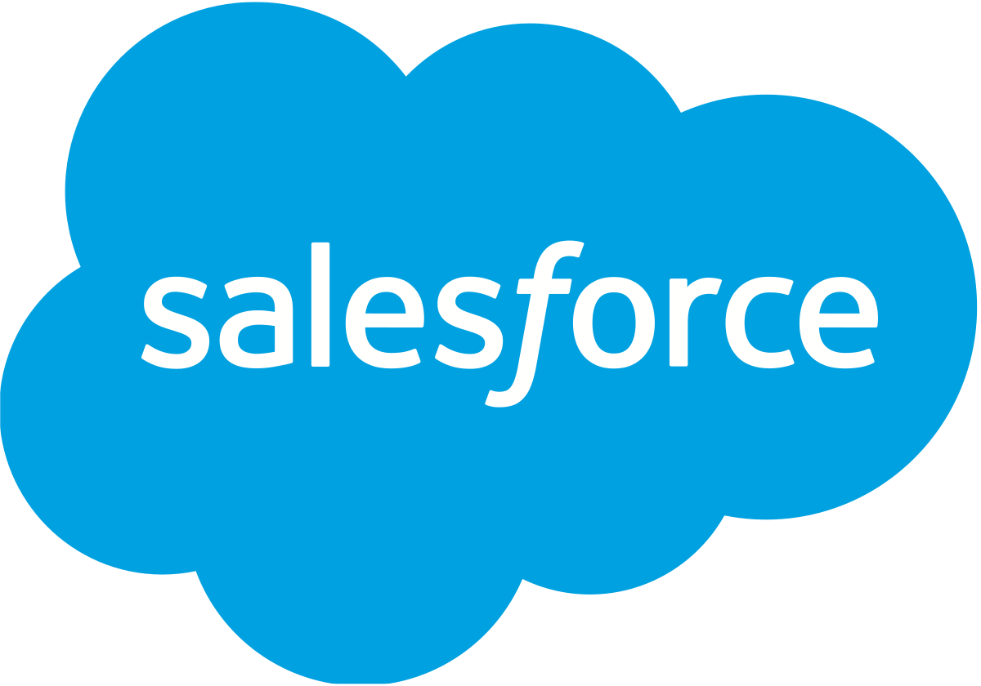

Slide 2
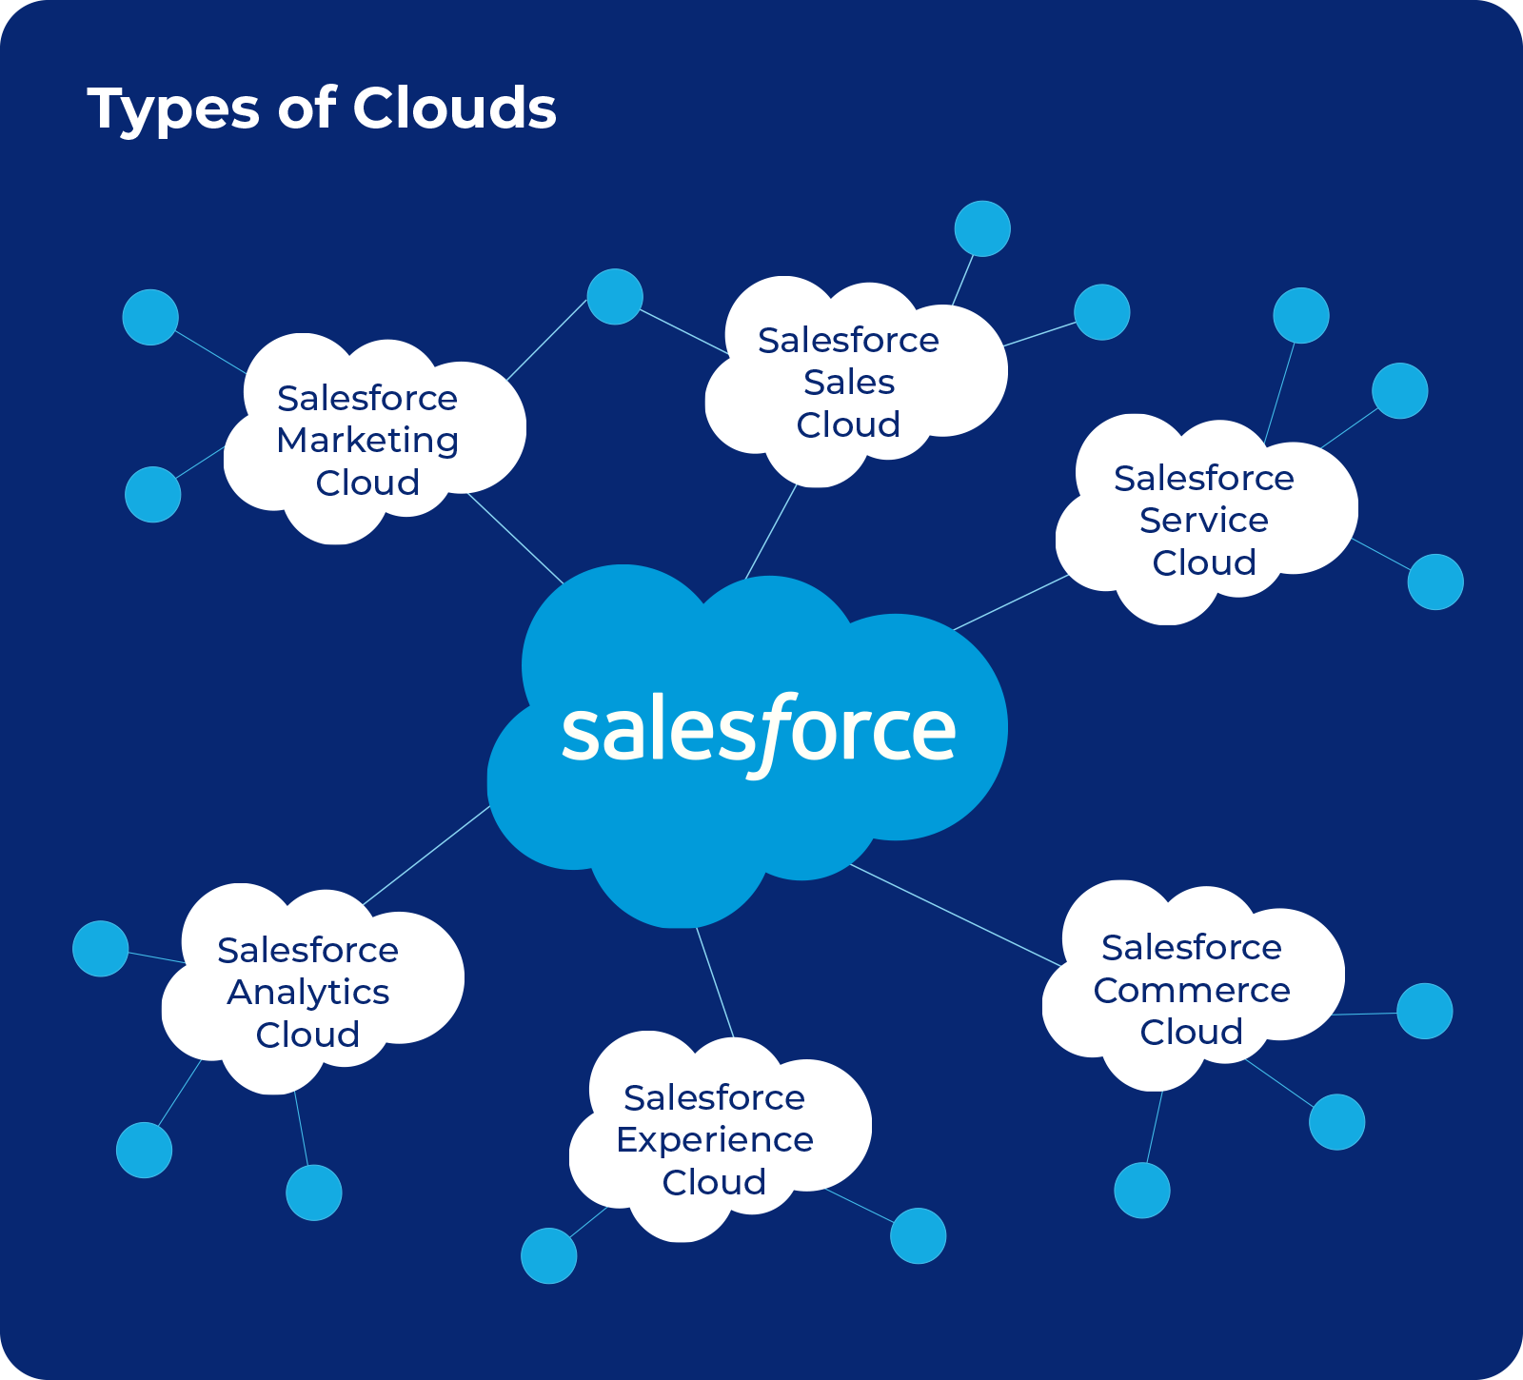
Introduction
Salesforce is a leading cloud-based Customer Relationship Management (CRM) platform that enables businesses to manage customer relationships, streamline operations, and drive growth through sales, service, marketing, automation, and analytics—all in one integrated platform.
It was founded in 1999 by Marc Benioff to revolutionize CRM through cloud computing.

Slide 3

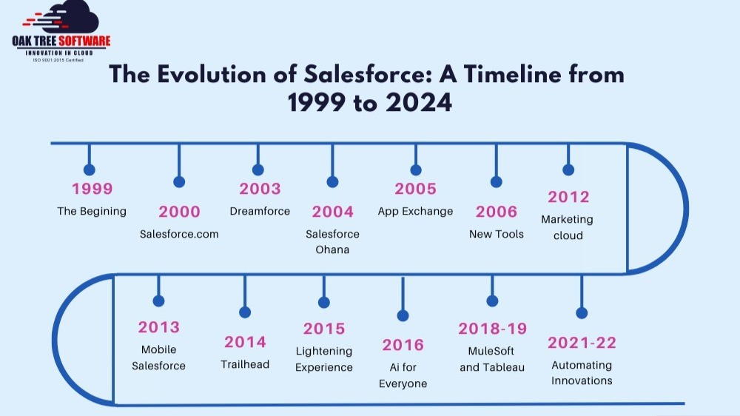


Slide 4
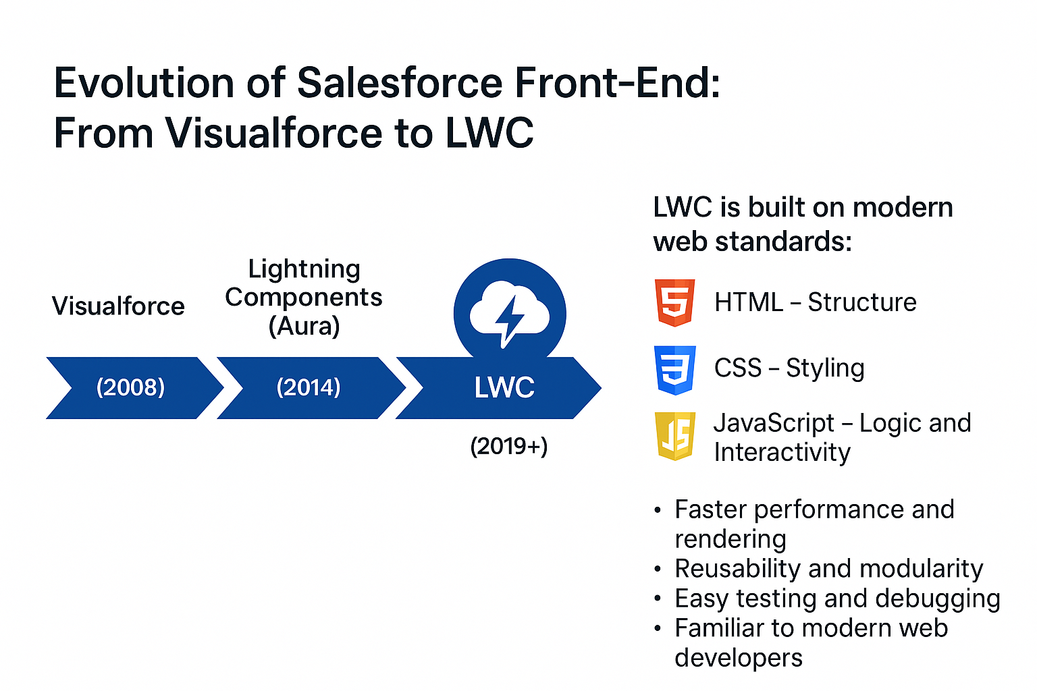
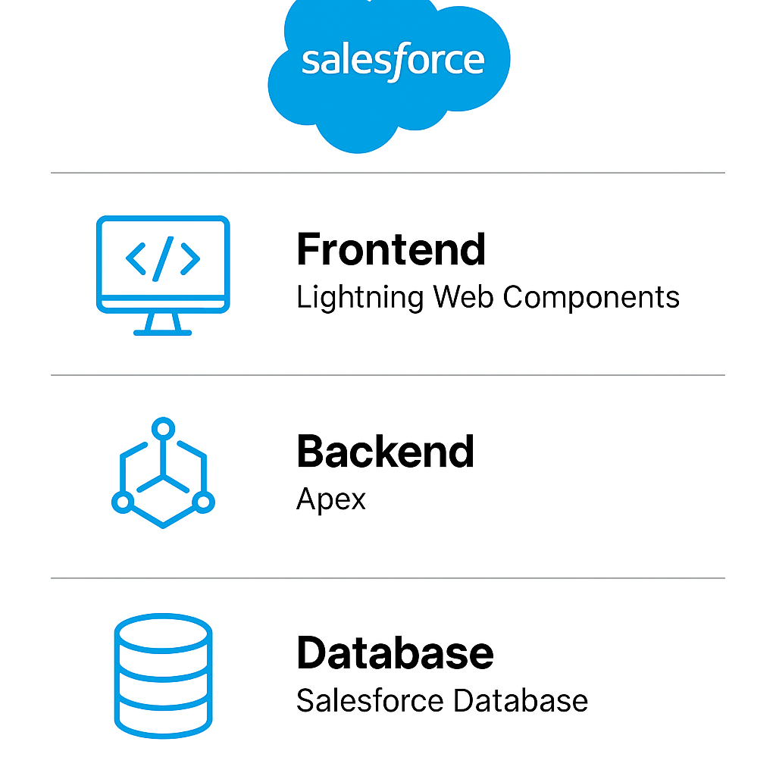

Slide 5
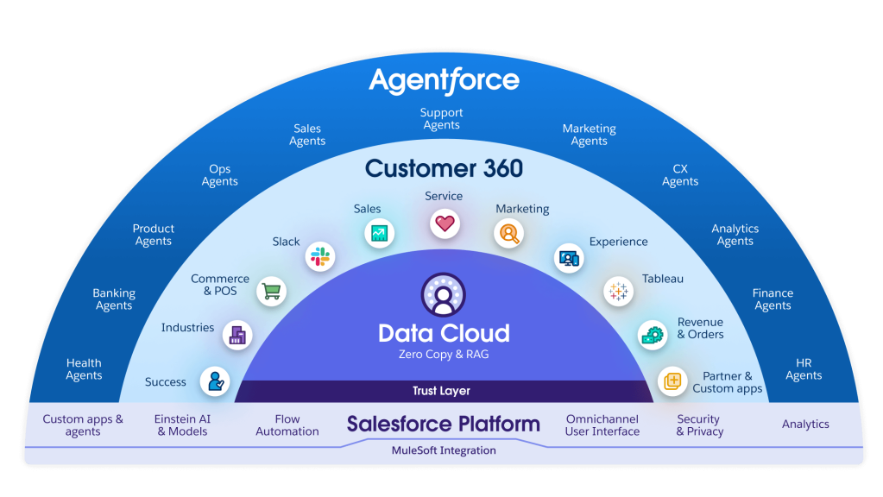

Slide 6



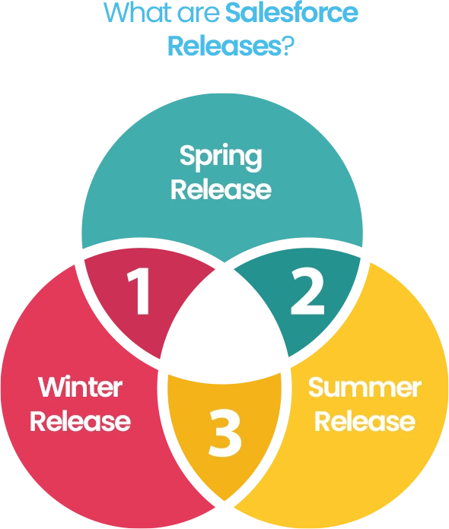
Fiscal Year
January 31st

Slide 7

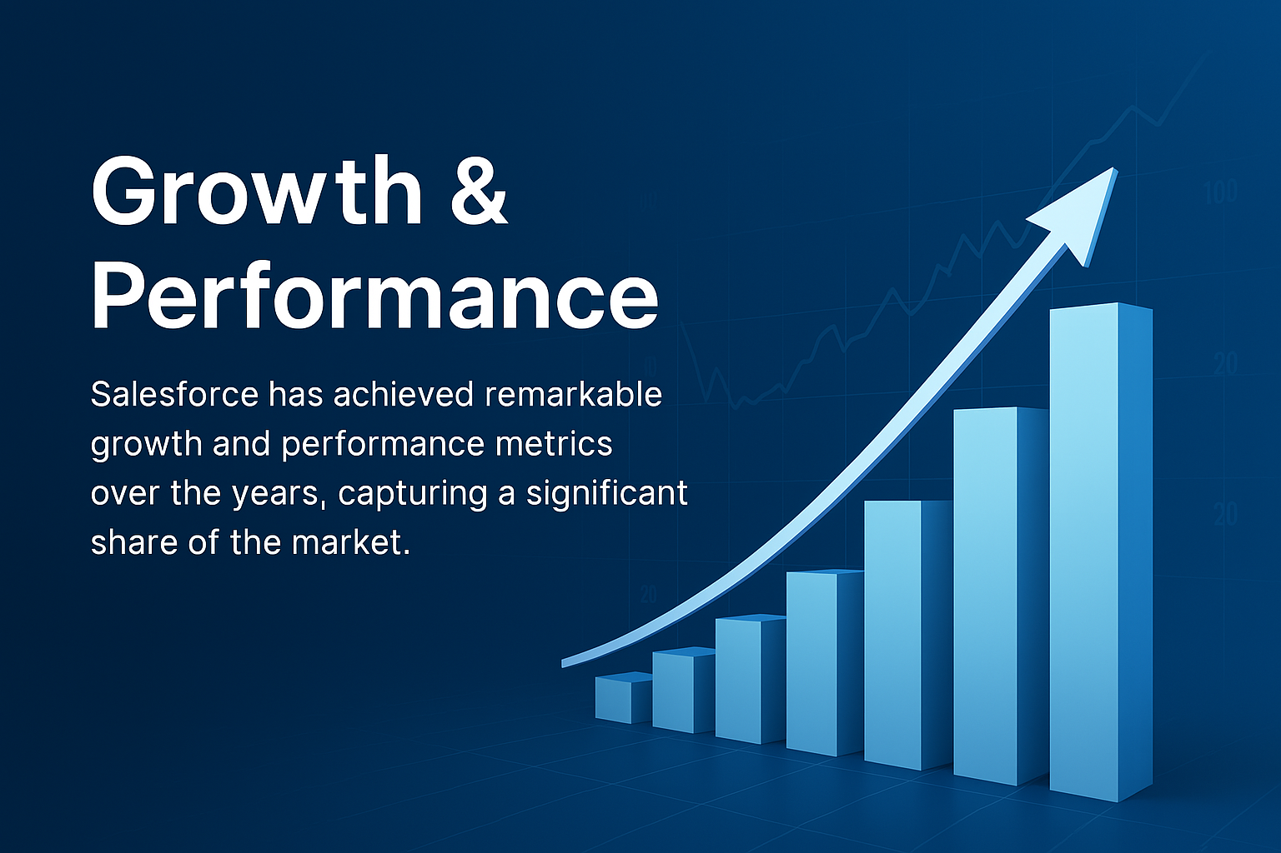
Revenue: $37.9 billion in FY 2025, up 9% Year over Year.
CRM Market Share: 21.7%, more than the next four competitors combined. The next four biggest CRM providers — Microsoft (5.9%), Oracle (4.4%), SAP (3.5%), and Adobe (3.4%) — together hold only 17.2%.
Key Growth Drivers: Subscription services (93% of revenue), Service Cloud, Marketing & Commerce Cloud.

Slide 8
Financial Planning
Assessing Financial Health (Where to Invest) - (Ratio analysis)
Understanding Risk & Return
(CAPM, P/E Ratio, Monte Carlo Simulation)
Forecasting Future Performance
- Prophet Model
Tactical Timing & Trade Execution
- EMA & SMA Strategy
Formulating Investment Strategy

Slide 9

Assessing Financial Health

Slide 10

Liquidity Ratio
Current Ratio remained above 1.0 every year, indicating Salesforce consistently had enough current assets to cover its short-term liabilities.
Quick Ratio stayed stable between 0.90–0.96, showing strong immediate liquidity even without relying on inventory.
Cash Ratio improved from 0.25 in 2022 to 0.32 by 2025, reflecting enhanced cash management and higher liquidity reserves.
Salesforce maintained a healthy liquidity position throughout the 4 years, ensuring solid short-term financial stability and operational flexibility.
2025
CR – 1.06
QR – 0.93
CR – 0.32

Slide 11

Profitability Ratio
Gross Profit Ratio increased steadily from 73.48% (2022) to 77.19% (2025) — showing efficient cost control and strong product margins.
Operating Profit Ratio rose significantly from 2.07% to 20.23%, reflecting improved operational efficiency.
Return on Assets (ROA) grew from 1.52% to 6.02%, showing better utilization of assets to generate income.
Return on Equity (ROE) increased from 2.48% to 10.13%, indicating improved returns for shareholders.
Return on Sales (ROS) mirrored operating profit trends, climbing to 20.23%, showing increased profitability from sales.
Return on Investment (ROI) rose from 6.08% to 8.90%, indicating stronger returns on invested capital.
It has shown remarkable improvement in all profitability ratios over the past 4 years, signaling stronger financial performance, operational efficiency, and investor value creation.

Slide 12
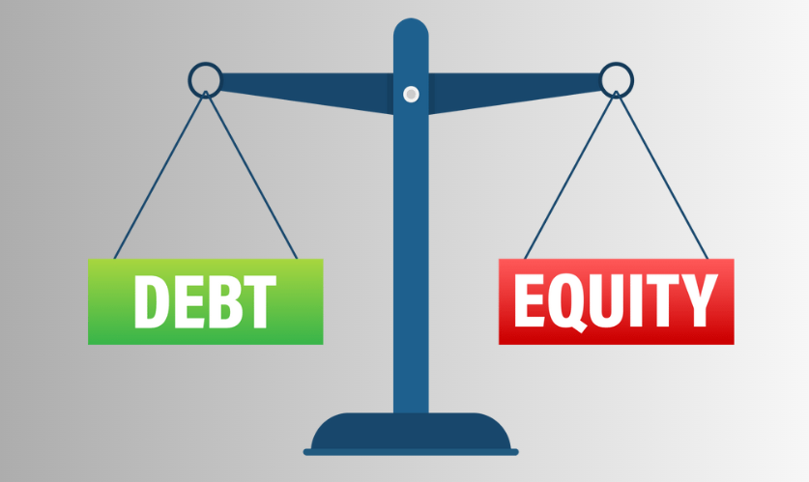

Long-Term Financial Strength
Solvency Ratio (SR) improved steadily from 0.13 in 2022 to 0.23 in 2025, indicating increasing capacity to meet long-term obligations.
Debt-to-Equity (D/E) Ratio declined from 0.24 to 0.19, showing Salesforce reduced its reliance on debt financing relative to shareholder equity.
Salesforce has strengthened its long-term financial position by gradually reducing debt and improving solvency. This indicates lower financial risk and more sustainable capital structure over time.

Slide 13


Slide 14

Salesforce Earnings Performance & Dividend Policy
Earnings Per Share (EPS) increased sharply from 1.46 (2022) to 6.44 (2025), showing strong profit growth per share.
Price-to-Earnings (P/E) Ratio dropped from a very high 787.80 in 2023 to a more reasonable 53.04 in 2025, reflecting improved investor confidence and earnings valuation alignment.
Dividend Payout Ratio in 2025 is 24.8%, indicating Salesforce began returning value to shareholders while still retaining profits for growth.

Slide 15
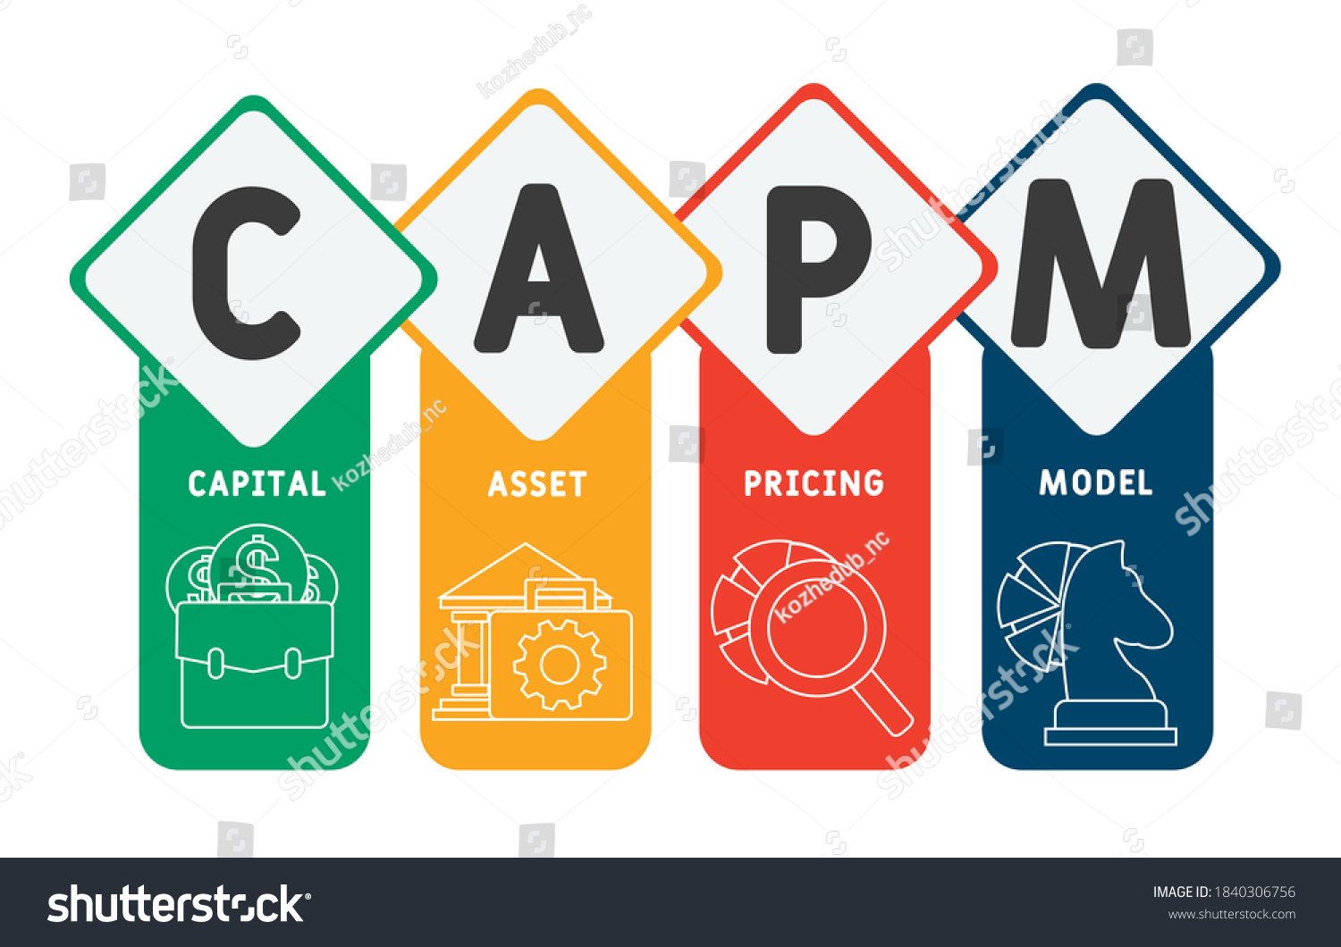
CAPM(Capital Asset Pricing Model)
Risk-free rate (Rf): 4% (based on the U.S. 10-year Treasury yield)
Market return (Rm): 10% (average return of the S&P 500)
Beta (β): 1.38
Expected return = 12%

Slide 16
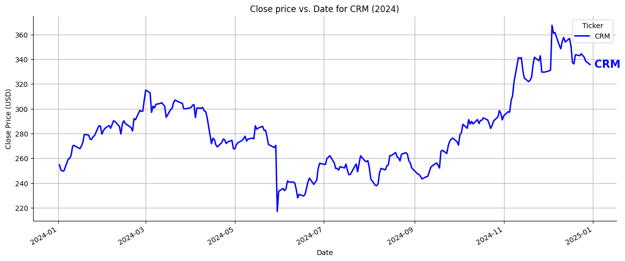
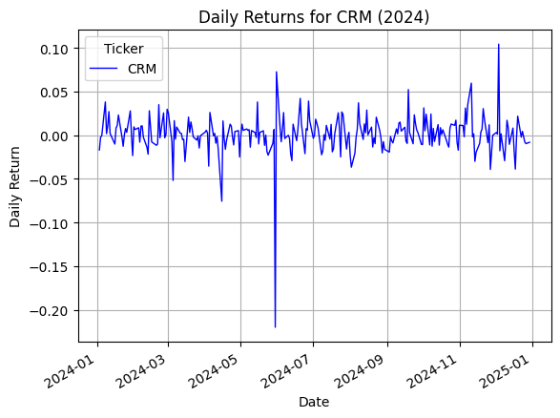
CRM 2024: Stock Movement and Daily Market Behavior
CRM stock showed strong growth in 2024, rising from ~$250 to ~$360 by year-end. Despite mid-year volatility, it ended on a high, reflecting strong investor confidence and performance recovery.
CRM’s daily returns were mostly stable, with occasional spikes in volatility. A sharp negative return occurred mid-year (around June), while a significant positive return appeared late in the year, indicating key market-moving events.

Slide 17
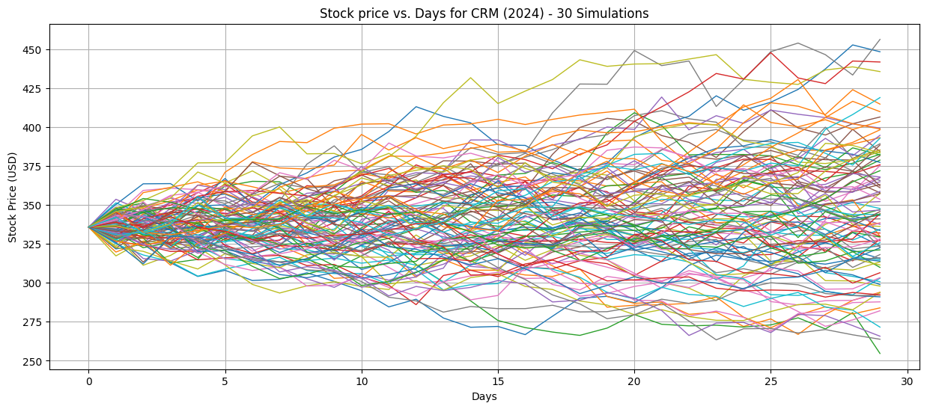
Monte Carlo Simulation
Insights:
The Monte Carlo simulation for CRM shows most stock paths ranging between $310 and $390, indicating moderate volatility.
There are a few outliers above $425 and below $275, reflecting potential short-term uncertainty. The overall trend suggests a balanced mix of risk and opportunity in the near term.
Recommendations:
Investors should prepare for price fluctuations and consider diversifying or hedging short-term positions. Stop-loss or limit orders can help manage risk effectively during volatile periods.

Slide 18

Forecasting Future Performance

Slide 19
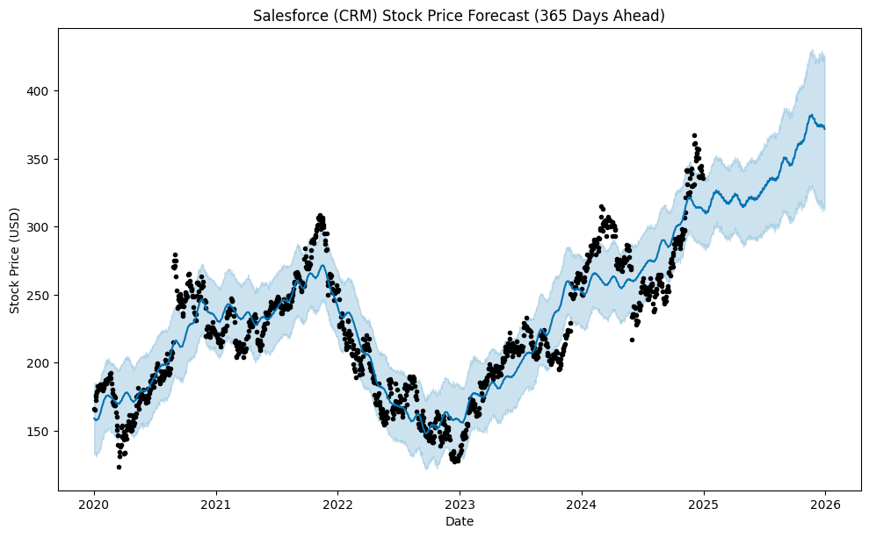
Prophet
Insights:
The forecast shows a strong upward trend in Salesforce (CRM) stock over the next 12 months.
The price is projected to reach above $400, with a confidence band reflecting moderate uncertainty.
Historical growth patterns align with the predicted continuation of positive momentum.
Recommendations:
Investors may consider long-term holding to capitalize on the expected upward trajectory.
Gradual entry (DCA) can help manage risk amid short-term fluctuations.
Monitor earnings reports and product announcements as potential price drivers.

Slide 20
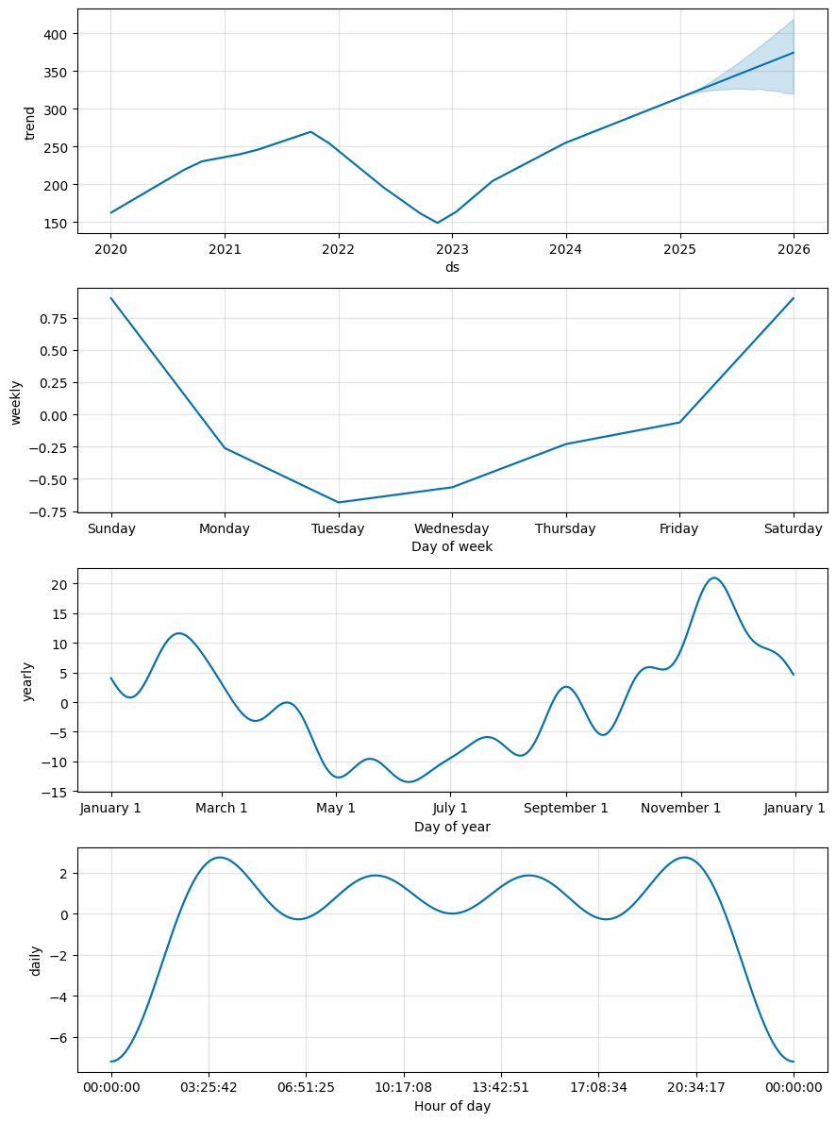
CRM Stock Trend & Seasonality Analysis
Trend (Top Plot): Salesforce’s stock shows a clear upward trend from 2023 onward, with continued growth forecasted into 2026.
Weekly Pattern: Returns tend to be lowest on Tuesdays and highest on weekends, especially Saturdays, suggesting weekly investor sentiment patterns.
Yearly Pattern: Peaks are typically seen in February–March and again in October–November, indicating seasonally strong performance in early and late year.
Daily Pattern: Price momentum is strongest early morning and late evening, while midnight to early morning sees the weakest activity.

Slide 21
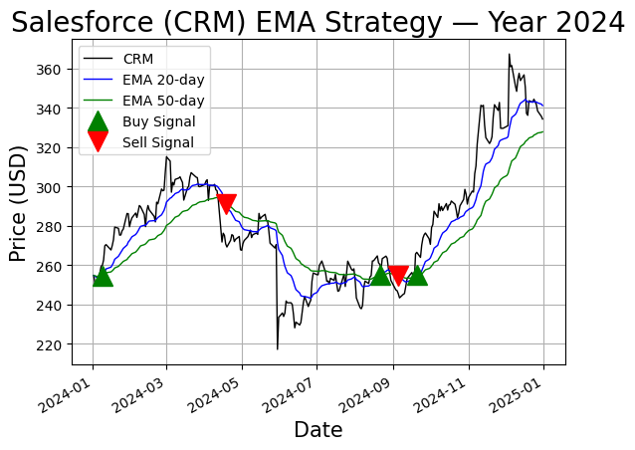
Riding the Trend: EMA Strategy in Action
Buy Signals in Feb and Sep led to strong rallies, confirming good entry points.
Sell Signals in May and October helped avoid downturns and secure profits.
Uptrends were confirmed when the 20-day EMA stayed above the 50-day EMA.
Mid-year showed high volatility — EMA crossovers helped navigate choppy moves.
Strategy effectively captured major price swings, enhancing timing for trades.
When the faster EMA (20-day) crosses above the slower EMA (50-day) → 📈 bullish signal → Buy
When the faster EMA (20-day) crosses below the slower EMA (50-day) → 📉 bearish signal → Sell

Slide 22
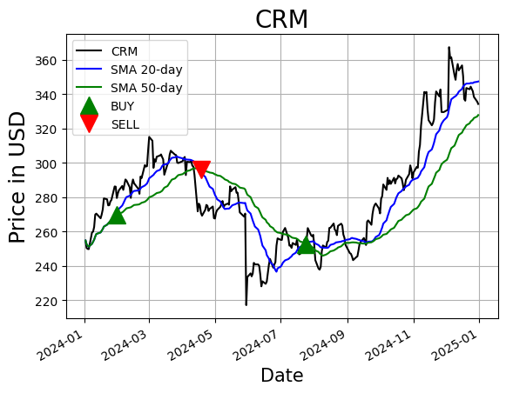
CRM Stock Strategy: SMA-Based Signals
Buy signal in Feb and sell signal in April captured the early-year uptrend effectively.
SMA crossovers smoothed out noise, confirming longer-term trends with less volatility than EMA.
The late 2024 rally was well-supported by SMA alignment, signaling strong sustained momentum.

Slide 23

Salesforce’s acquisitions of Slack and Tableau were strategic financial decisions backed by strong planning, solid financial health, and market-driven insights—showing how smart analysis leads to impactful actions.

Slide 24
Thankyou

